Slide 1
IaRT – CHECKPOINT 1
Daniel Brandão – 201705812
Pedro Moás – 201705208
Gaspar Pinheiro - 201704700

Slide 2
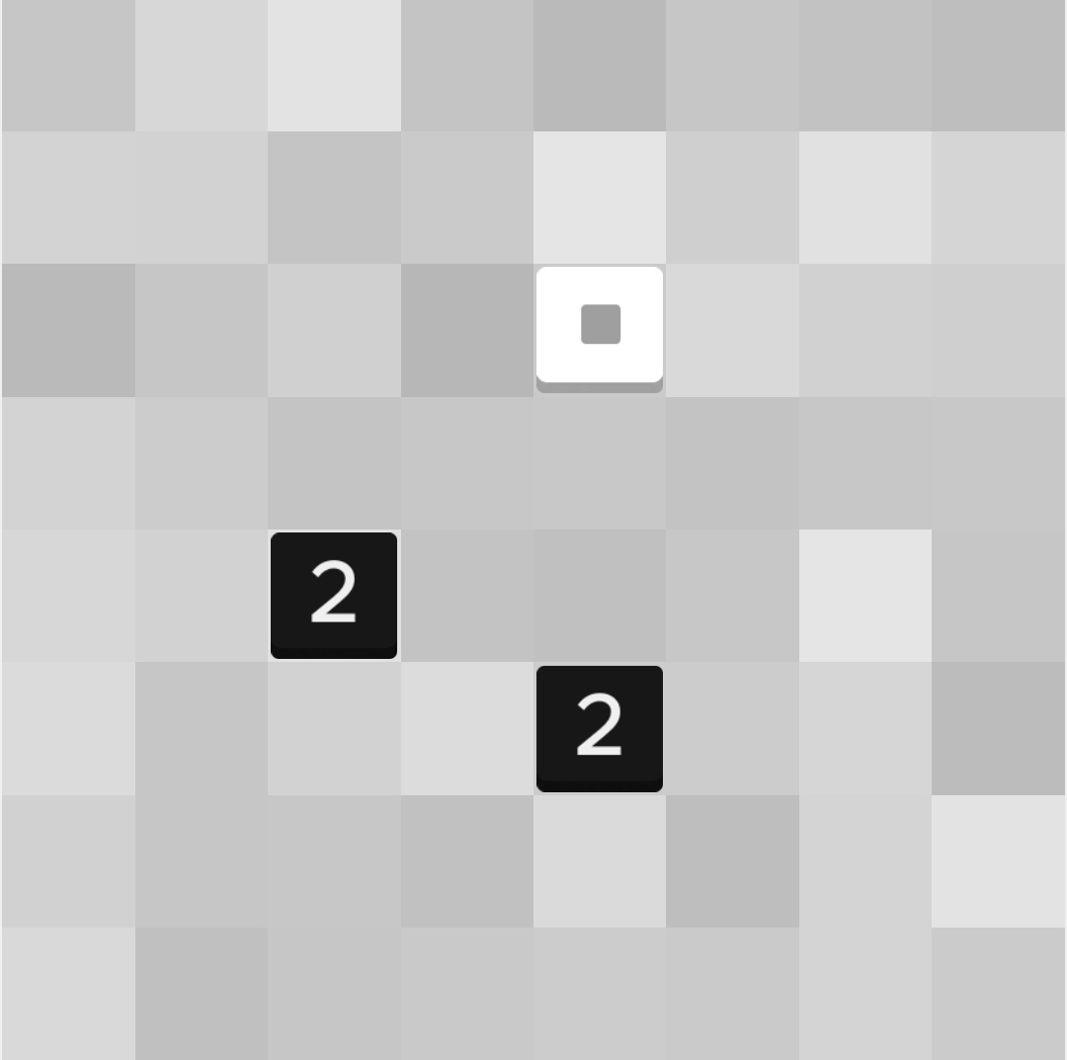
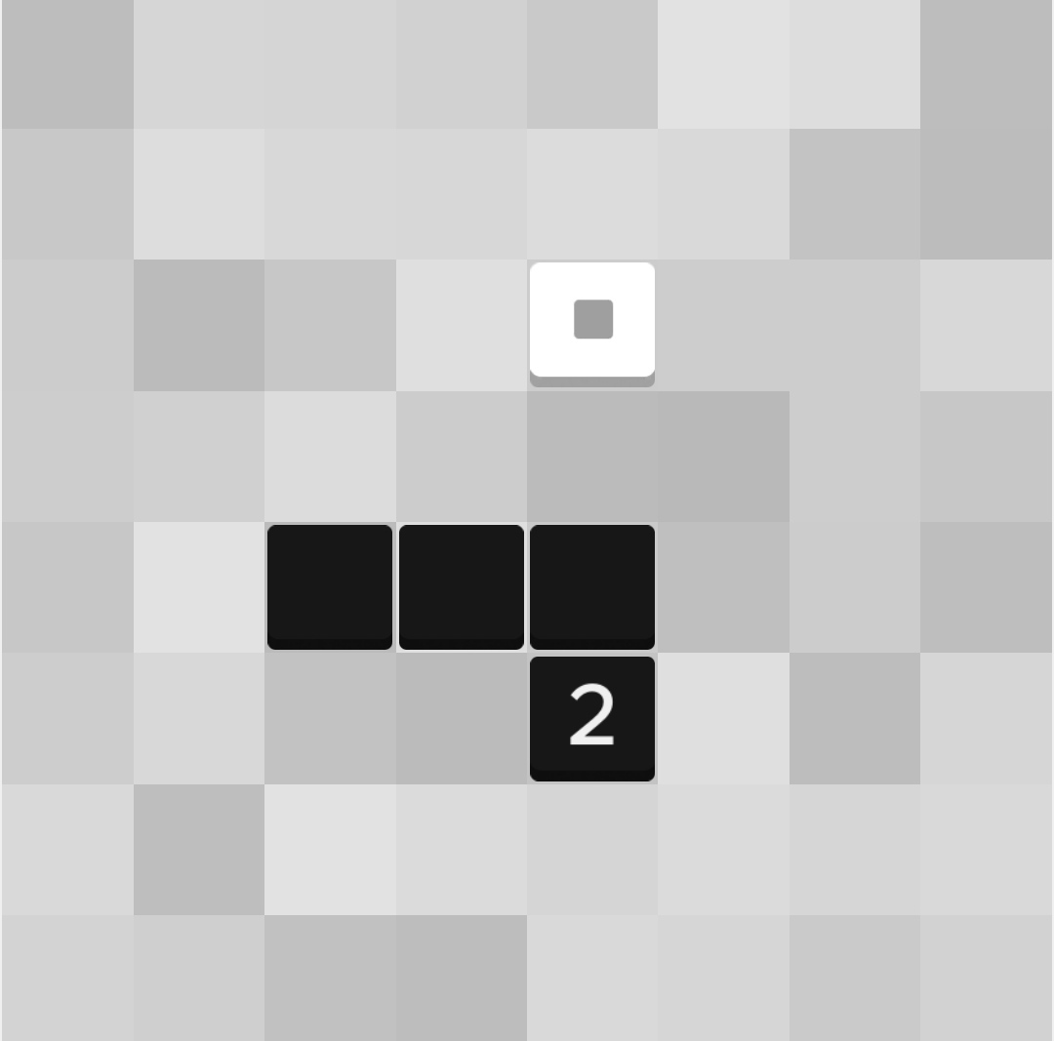
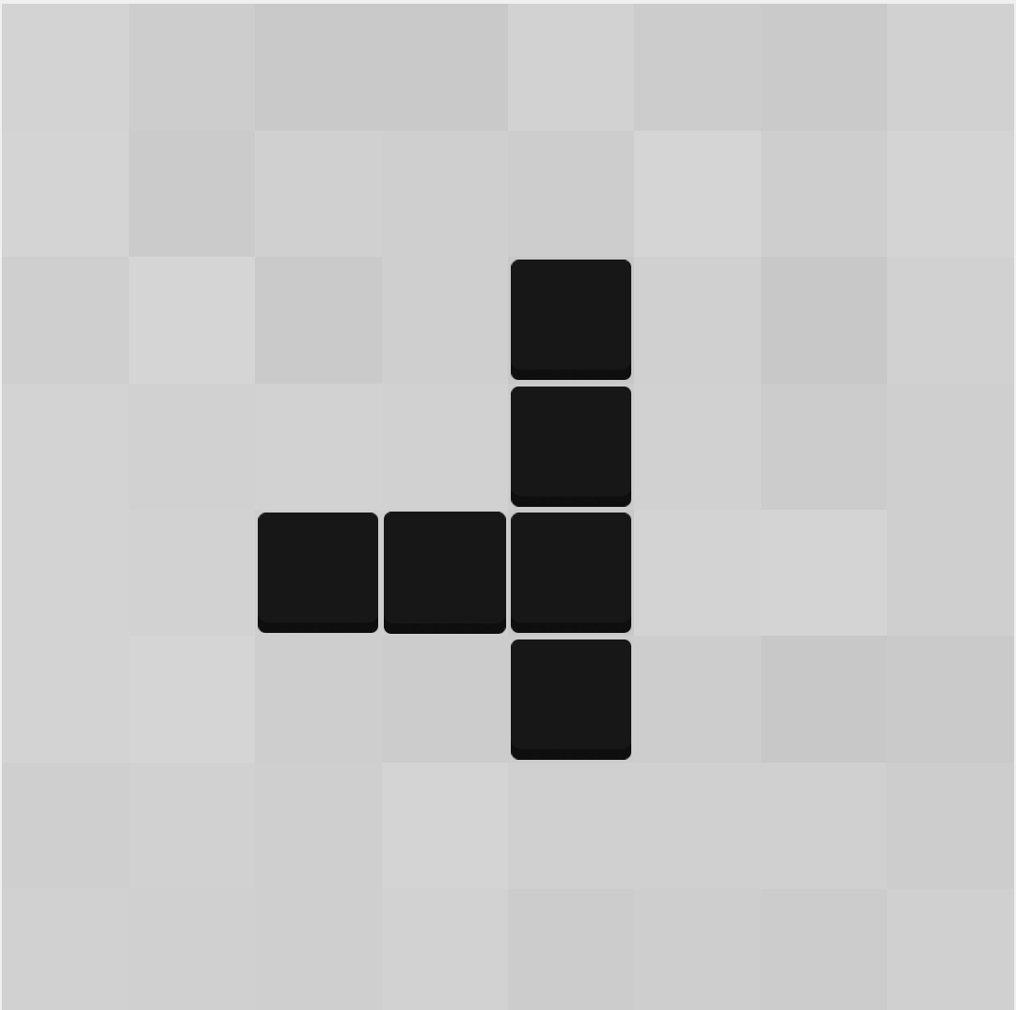
ZHED - Single Player Game
ZHED is a grid based puzzle game where in order to complete each level a numbered cell must be expanded to reach the goal cell.
Each numbered cell can be expanded in one of four directions and overlapped. Each cell expands n cells in the direction chosen, decreasing by one for each empty cell. When a expanding cell overlaps an already filled cell, the number of cells to be filled in the direction of the expansion is not decreased.

Slide 3
Problem Formulation
For each level, the puzzle size and the numbered cells' positions are diferent. Therefore we are using as an example for the formulation a puzzle size of 4.
State Representation: NxN Matrix (List of Lists of integers, N = Puzzle Size), where each cell can have a value, Val, of:
A positive number, representing the expandable length of the cell;
0, representing an empty cell;
-1, representing an expanded cell;
-2, representing the goal cell.
-3, representing the reached goal cell.
Initial State: Matrix with at least one Val = -2 , at least one Val > 0, and no Val = –1 or Val = –3 cells
Final State: Matrix with one Val = -3
1 | 0 | -2 | 0
0 | 0 | 0 | 0
0 | 0 | 0 | 3
0 | 2 | 0 | 0
Initial State example
-1 | -1 | -3 | 0
0 | -1 | 0 | 0
-1 | -1 | -1 | -1
0 | -1 | 0 | 0
Final State example

Slide 4
Operators
Operator | Pre-conditions | Effects | Cost
Move [X,Y] Up | Board(X,Y) > 0 | i = 1; While (i <= Board(X, Y)) If (Board(X, Y – i) != 0) continue; Board(X, Y – i) = -1; i++; | -30
Move [X,Y] Down | Board(X,Y) > 0 | i = 1; While (i <= Board(X, Y)) If (Board(X, Y + i) != 0) continue; Board(X, Y + i) = -1; i++; | -30
Move [X,Y] Left | Board(X,Y) > 0 | i = 1; While (i <= Board(X, Y)) If (Board(X - i, Y) != 0) continue; Board(X - i, Y) = -1; i++; | -30
Move [X,Y] Right | Board(X,Y) > 0 | i = 1; While (i <= Board(X, Y)) If (Board(X + i, Y) != 0) continue; Board(X + i, Y) = -1; i++; | -30

Slide 5
Approach
For the heuristic methods (greedy, A*), we used different heuristics, such as:
H1 = Minimum Zhed Distance between a Value Cell and a Finish Tile.
H2 = (1 - Number of Reached Finish Tiles) / (Number of tiles aligned with a Finish Tile)
H3 = (1 - Number of Reached Finish Tiles) * 1000 /BoardMaxValue
H4 = (1 - Number of Reached Finish Tiles) * 1000 /BoardTotalValue
H5 = H2 + H4
The Tile Extension Value is the number of tiles a Value Tile can extend in a certain direction (extending through a Value Tile only adds half the value as other Tiles)
The Zhed Distance between a Value Cell and a Tile, only applicable when they are in the same row or column, consists of:
(The actual distance between them) - (The number of used tiles between the) - (The Cell's Value)
BoardMaxValue: Sum of the Maximum Tile Extension Value of each Value Tile in the Board and the number of expanded cells
BoardTotalValue: Sum of the Average of all 4 Tile Extension Values of each Value Tile in the Board and the number of expanded cells

Slide 6
Implemented algorithms
We implemented DFS, BFS, Greedy, A* and Uniform Cost Algorithms.
For DFS and BFS, no heuristic and cost functions were used.
For Greedy and A*, several heuristics were tried, as explained in the previous slide.
For Uniform Cost and A*, only one cost function was used, as it experimentally did not significantly impact the obtained results.

Slide 7
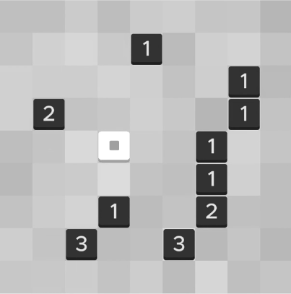
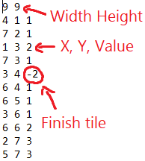
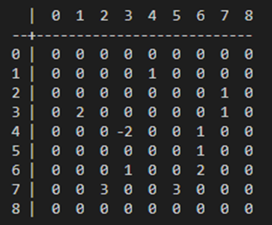
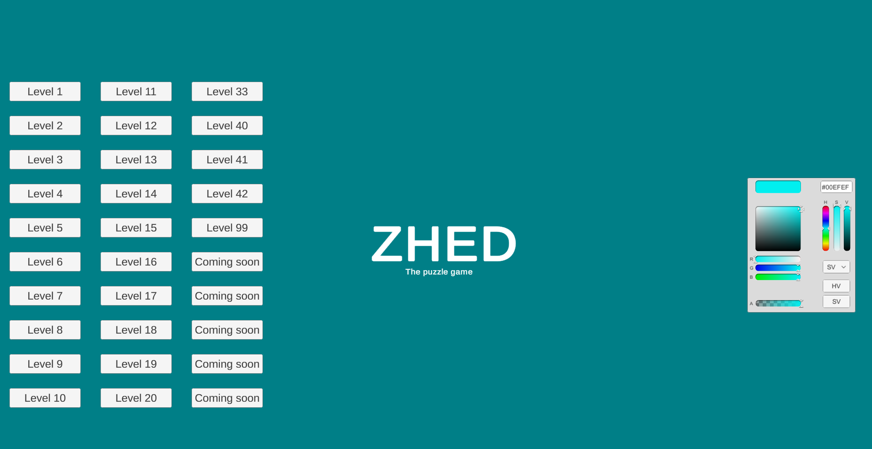
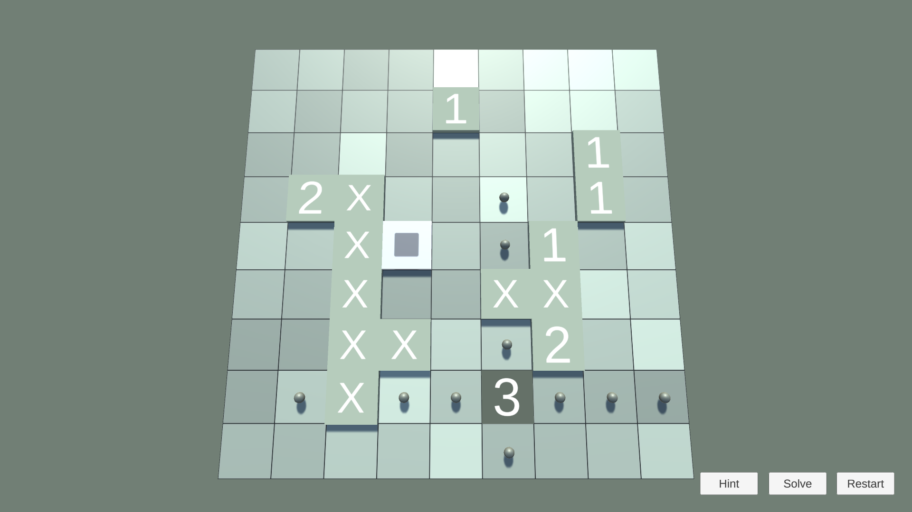
Development
We used Unity and C# as a programming language .
For Zhed Level 41, its file structure, console and graphical representation are shown below:
Zhed App
File representation
Console
Zhed - Menu
Graphical

Slide 8
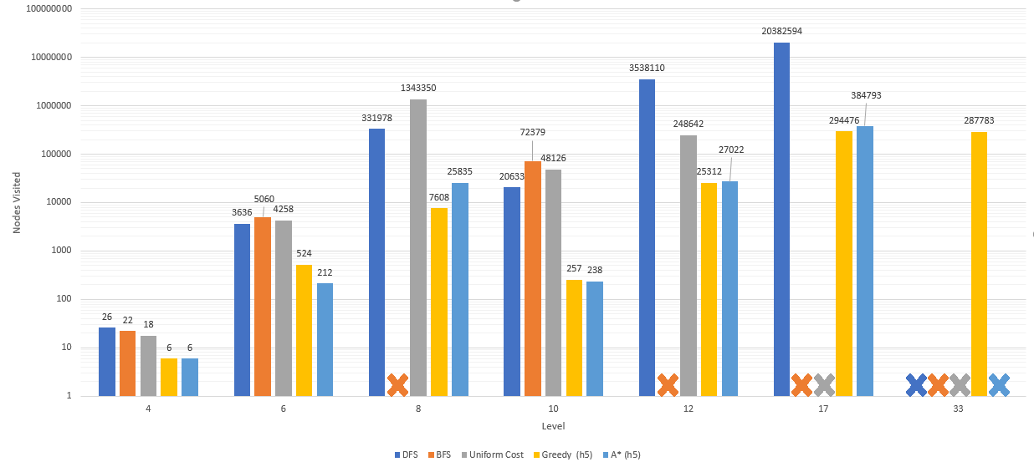
Results
Nodes Visited in different levels for each algorithm
Nodes Visited in different levels by diferent heuristics with greedy algorithm
Solve time(ms) for diferent levels by diferent heuristics with greedy algorithm
Level | h1 | h2 | h3 | h4 | h5 (h2 + h4)
6 | 1268 | 463 | 246 | 5083 | 524
8 | 157997 | 61788 | 10532 | 77683 | 7608
10 | 18231 | 2960 | 864 | 1298 | 257
12 | 163121 | 45540 | 333449 | 645831 | 25312
Level | h1 | h2 | h3 | h4 | h5 (h2 + h4)
6 | 39 | 18 | 11 | 27 | 18
8 | 4658 | 2436 | 522 | 2496 | 461
10 | 492 | 115 | 37 | 42 | 12
12 | 5123 | 2042 | 10855 | 3014 | 827

Slide 9
Conclusions
Overall, we have successfully implemented search algorithms on a Zhed Solver, not only uninformed ones such as DFS and BFS, which are simpler to implement but end up taking 5-10 times as long, and also informed search algorithms, which can have better heuristics for different levels, as the solutions for each level can be very different.
For instance, heuristic 4 performs a lot better than heuristic 2 (more than 2x) on Level 10, but worse on Level 12 (~1.5x).

Slide 10
Related Work
https://www.wilgysef.com/articles/zhed-solver/
https://github.com/WiLGYSeF/zhed-solver
https://www.cin.ufpe.br/~if684/EC/aulas-IASimbolica/korf96-search.pdf
http://archive.oreilly.com/oreillyschool/courses/data-structures-algorithms/singlePlayer.html
http://www.pvv.ntnu.no/~spaans/spec-cs.pdf

